Slide 1
Pharmacokinetics (PK) Secure Data (SD) Office
Banyan Park | May 17, 2016

Slide 2
PK Data Workflow
Clinical DB Management System
Statistical Analysis
Biostatistics
CRF Time points
Merged Concentration Data
PK Parameters
Clinical Study Report
Concentration Results
WinNonLin
Bioanalytical Lab
Standalone PK Report
Issues:
Three different data sources
Three different departments
Three different systems
No data standards
PK Office Activities
Pharmacokineticist
2

Slide 3
PK SD Office Set up
An independent dedicated group within TCS CDM and Stats programming and PK team
No link with CDM, Stats & Programming and PK core team
Staff:
Data Managers
SAS programmers
PK analyst
Manage unblinded data streams/programming
Are unblinded before database lock
A secure IT environment
Separate folders with only access by SD Office team members
Secure exchange medium
3

Slide 4
PK SD Office Tasks – Managing Open Label Trials
Activities to be handled by PK SD Office for Open Label Trials
Managing PK data transfer specification
Reconciliation of PK data
Creating PC data in coordination with BAN and TCS DM team
Perform PK merge in coordination with TCS BnP team
Creating input and output file for NCA analysis
Create PP and ZP datasets
Provide final PC, ZP and PP datasets (including SUPPP and RELREC) to TCS DM and TCS BnP team
Create e-submission package
4

Slide 5
PK SD Office Tasks – Managing Blinded Trials
In addition to the activities handled for open label trials, following activities will be managed by TCS PK office for blinded trials
All DM activities and SAS programming with data that can unblind a study are to be handled within PK SD office
Handling of pharmacokinetic data
Handling of other blinded data (Laboratory data, Antibody data, etc.)
Programming of PK/PD input files (NCA)
Randomization data
Creation of randomization lists
Distribution/release of randomization lists
Cleaning randomization data
Handling of ‘limited’ access data (e.g., DNA results, linking of de-identified samples, de-identification of database)
5

Slide 6
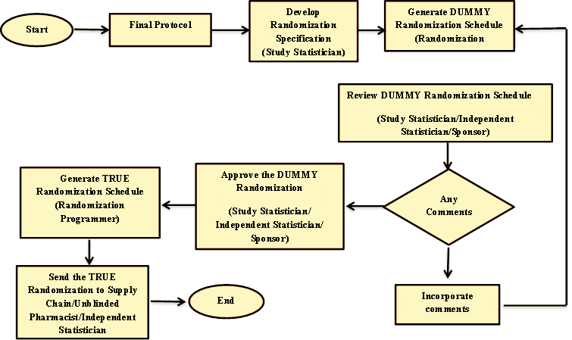
Randomization Schedule Generation Process
6

Slide 7
PK SD Office Requirements
Standardization
CDISC standards
Easy translation of protocol information to datasets
Additional time and resources can be saved by creating validated macros for merging the standardized data
Standard check can be implemented to check quality and completeness of instream data
Internal processes
Well documented specifications / transfer agreements
Communication is key, several stakeholders involved
Bio-analysis laboratory (PK concentrations)
Data Management (Source data - as clean as possible)
Statistics (Derivations)
PK groups (PK analysis)

Slide 8
Appendix

Slide 9
Overall PK/SD Office Process Flow
3
Central Lab
Sample and shipping list
Bo-Analytical Lab
Sample & lab requisition form
4a
4b
1
BAN sample identifier file
2
Sample Reconciliation File (During conduct)
BAN Sample result file (after analysis)
Investigational Site
SDTM dataset per DTA and PC dataset
6
5
7
eCRF
Clinical Data Management (CDM)
PKO sample identifier file
PK Office
SDTM PC
11
SDTM PP
8
Analysis Dataset
10
PP file (from ClinPharm)
ClinPharm STO/AM&S
BSP
PK/PD analysis transfer (For NCA: STO & For NONMEM: AM&S)
9
9

Slide 10

PC Data Processing after DB Lock
TCS- CDM
LDM/Designee: Initiate
GDO FRM-12549 Request for Data Release/Unblinding
Stats programmer: Generate FINAL SDTM PC dataset & share it with PK office along with predefined datasets
Stats programmer: Received final PC file & perform structural checks
1
1
4
B
Any issues?
Y
N
Stats programmer: PC finalized
5
PK stats Programmer: Receive the request for data release & FINAL SDTM PC file
If issues related to received PC file
PK office
PK stats programmer: Combine two files & generate FINAL PC file & then execute edit checks
Y
Any issues?
N
2
PK DM: Receipt of FINAL result file
END
3
Y
2
A
If ssues related to received FINAL result file
Generate FINAL result file from LIMS & send it to PK office
BAN
1
A
gDTA between PK office & BAN
START
B
gDTA between PK office & TCS CDM
10
QC/Review Tracker

Slide 11
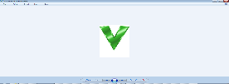
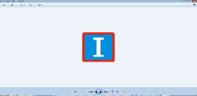
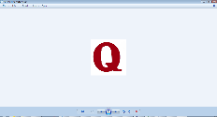
Generation of NCA and NONMEM Input File
TCS-CDM
Stats programmer: Final PC file
START
E
gDTA for NCA files between Pk office, BnP, & ClinPharm
1
B
gDTA between PK office & TCS- CDM
TCS- B&P
QC/Review Tracker
E
Stats programmer: Populate derived variables in Final PC file & give it to PK office
Validation Tracker
Issue Log
2
B
Y
PK office
PK DM: Is file compatible with tsDTA?
QC NCA/NonMEM input file-Any issues?
N
Y
PK stats programmer: Create & validate Raw NCA & NonMEM input file then share it with CP
Y
3
PK stats programmer: Receipt of final NCA input file
END
N
5
ClinPharm (CP)
E
E
Y
Receipt of NCA input file by STO
Any issues?
N
Modify & create final NCA input file & share it with PK office
Receipt of NCA & NONMEM input file & share it with AM&S & STO for analysis
4a1
4a2
Y
Receipt of NonMEM input file By AM&S
Any issues?
N
Perform NonMEM analysis
END
4
4b1
11
4b2

Slide 12


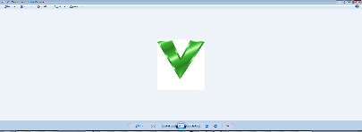
Generation of final eSubmission Package
F
gDTA for PP files between Pk office, BnP, & Clin Pharm
IDS
Receive final files & create final e-submission package:
END
G
tsDTA for NCA PP files between Pk office, BnP, & Clin Pharm
5b3
QC/Review Tracker
Validation Tracker
TCS- B&P
Stats programmer: Receive files & review
Any issues?
N
5b1
Y
G
PK stats programmer: Share final files with IDS
PK office
Pk stats programmer: Receipt of final Input & output NCA file
PK stats programmer: Generate & validate PP, SUPPPP (if applicable), RELREC (updated), ZP*, SUPPZP** (if applicable) & define.xml datasets
PK stats programmer: Integrate PP, SUPPPP (if applicable), RELREC, ZP*, SUPPZP** (if applicable) & define.xml & create final PP e-submission package & Share it with BnP for review
5b2
3
4
5
PK DM: Generate NCA esubmission package & send it to CP
F
G
5a1
ClinPharm (CP)
Final NCA input file
G
1
Places final NCA esubmission package files to IDS drop zone
Transfers NCA esubmission package files to regulatory (upon request)
Analyze final input file &Generate Final NCA output file
END
2
START
5a2
5a3
12
ZP* & SUPPZP** : Out of scope

Slide 13
Share eSubmission Package with IDS
IDS
Receive final eSubmission package for the regulatory submission.
N
Final eSubmission package ready for the regulatory submission.
Any issues?
END
4
5
Y
TCS-CDM
Stats programmer: Final datasets (post EDC lock) & define.xml are available with stats programmer-.
Stats programmer: Integrate PP, RELREC & define.xml & include PP, SUPPPP, PC, SUPPPC, RELREC datasets in e-submission package & share it with IDS
3
Stats programmer: Receive final PK e-submission package from PK office & perform structural review.
Any issues?
N
2
3
Y
PK office
PK stats programmer share Integrated PP, RELREC & define.xml package with TCS-CDM team.
START
1
QC/Review Tracker
13

Slide 14
Pharmacokinetics (PK) Analysis Capabilities
Banyan Park | May 17, 2016

Slide 15
TCS Phase I Experience: Activities by Study Type
SERVICE AREAS | Dose-Proportionality | Food Effect Assessment | DDI | QTc | Special Populations (e.g. Renal / Hepatic Impairment, Pediatric) | BA/BE | ADME (Mass balance) | SAD and MAD PK studies
Protocol Development | 16 | 19 | 5 | 1 | 15 | 25 | 7 | 12
Safety and Clinical Pharmacology Analysis Plan Development | 27 | 5 | 5 | 5 | 17 | 3 | 1 | 10
Data collection and delivery: eCRF creation; Perform DM & Data delivery activities in standard format (SDTM). Handle all data streams for a trial | 45 | 5 | 5 | 5 | 17 | 3 | 2 | 15
Non PK/PD Analyses: Perform Planned and AdHoc Analysis (summaries, descriptive and inferential statistics); Deliver analysis data sets in specific format (.e.g.ADaM) and analysis output per sponsor conventions | 45 | 5 | 5 | 5 | 17 | 3 | 2 | 15
Project management. Cross-functional review and input into critical documents before providing to sponsor for review/approval | 100 | 30 | 12 | 20 | 31 | 60 | 12 | 40
CSR development (including narratives etc.) | 45 | 29 | 12 | 4 | 31 | 60 | 12 | 35
Provide eSUB-ready documentation (define.xml, SAS transport files, reviewers guide) | 45 | 5 | 5 | 5 | 17 | 3 | 2 | 15
End to End Support for above services | 16 | 5 | 5 | 1 | 15 | 3 | 1 | 10
Provide final SAS programs along with documentation. | 20 | 2 | 3 | 3 | 17 | 0 | 0 | 7
Working with other Providers (e.g..: incorporating data from niche PK providers if needed) | 20 | 2 | 3 | 3 | 17 | 0 | 0 | 7
15

Slide 16
PK Data WorkFlow
Metadata
Clinical
Bioanalysis
Merged PC
Raw/ CDASH
Review
Intermediate
SDTM
PC
ADaM
NCA
Metadata
Analysis
Reports
PP/ ZP
ADSL
RELREC
ADPP
ADZP
ADPC
Statistics
PP TLFs
ZP TLFs
PC TLFs
16

Slide 17
PK Merge/PK Data Reconciliation
In PK merge we need to collate information from several panels and prepare a dataset which contains everything together
This includes
Age, sex, race
Height, Weight
Treatment information
PK sample time
Dosing time
PK concentration data (from Bio-analytical Lab)
Reconciliation is done prior to database lock to ensure that clinical database and Bio-­analytical databases have same subjects and same samples number
One more purpose of reconciliation is to ensure that the samples are taken close enough to the schedule

Slide 18
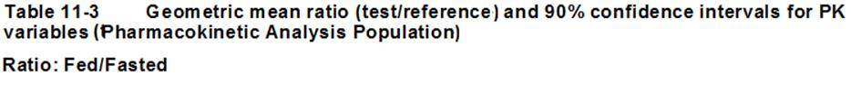
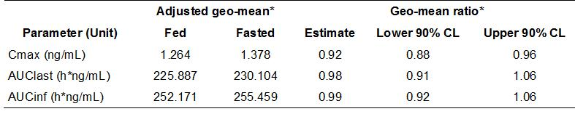
PK Summary Outputs
We produce summary Tables (PK concentration/Parameters), Listing (PK concentration/ Parameters), Plots(AM ± SD; GM ± SD; Individual subject profile, etc.) and statistical analysis Table
Example of some output that we finally produce

Slide 19
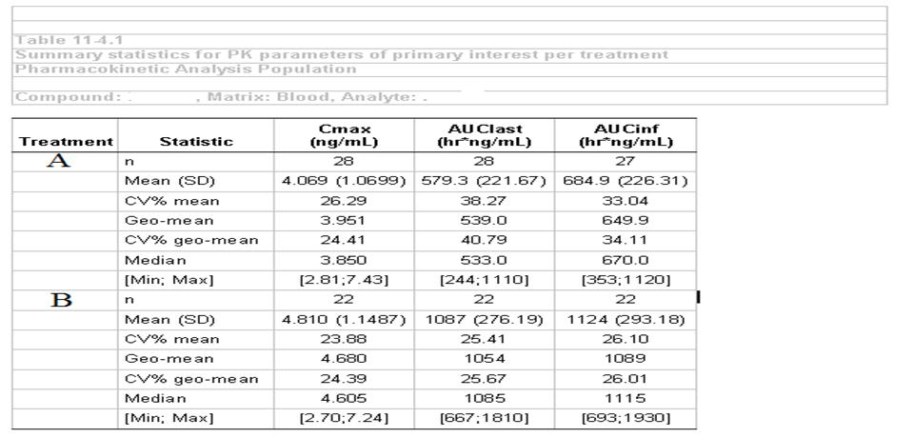
Sample PK outputs (Examples)
%tpksum (_tab=ITPPK1,
_class = DRGNUM1A,
_center_rep_ = nocenter,
_parmlist= cmax auclast aucinf);

Slide 20
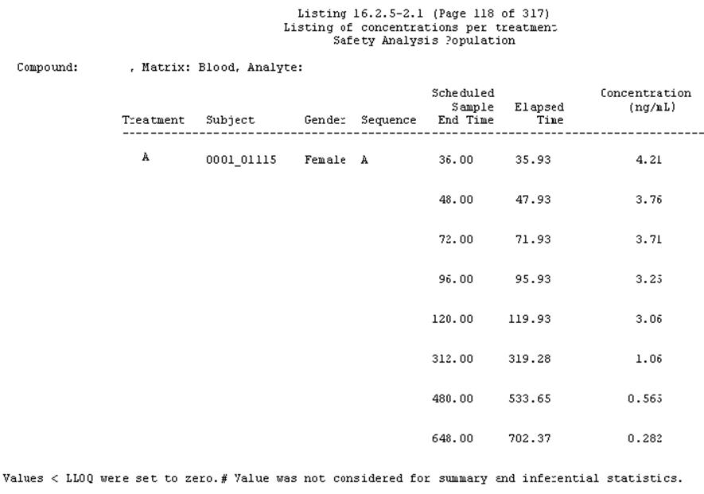
Example (Contd.)
%pk_list(_tab=PLLPC1,
_indsn = data_cp.a_pkconc,
_byordfmt = _null_ _null_ _null_,
_classofmt = $trti. _null_ _null_ _null_ _null_ _null_,
_classfmt = $trtf. _null_ _null_ _null_ 6.2 6.2,
_class = DRGNUM1A SID1A SEX1C TGP1A STM2N ELP_TIM0,
_classw = 10 12 6 8 9 8,
_anlvars = phkrsl1n);

Slide 21
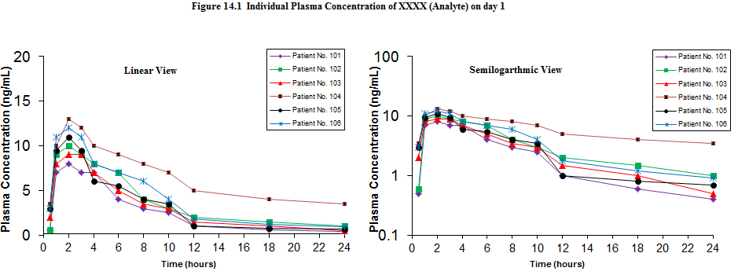
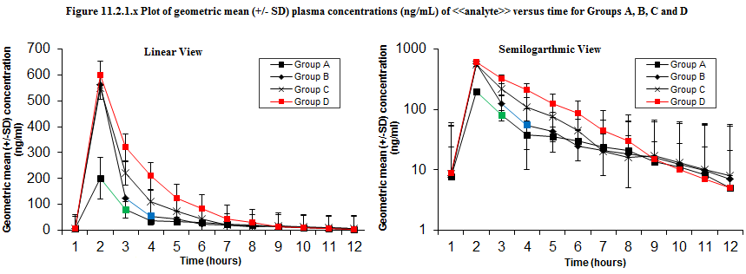
Example: Individual Plasma Concentration and GM± SD graph

Slide 22
Example of BA/BE Report

Slide 23
PK/ PD Analysis
Design: Phase 1, double-blind, relative bioavailability and tolerability crossover study in healthy male subjects.
PK/PD Objective: To explore the relationship of Test drug exposure and changes in blood pressure
Analysis:
Relationship between the changes from baseline in blood pressure versus Test drug exposure PK parameters explored graphically.
Changes in blood pressure and heart rate at T_{max} versus C_{max} and Test drug exposure parameters (AUC_{0-last}) presented using scatter plots along with the Pearson correlation coefficient and p-value.

Slide 24
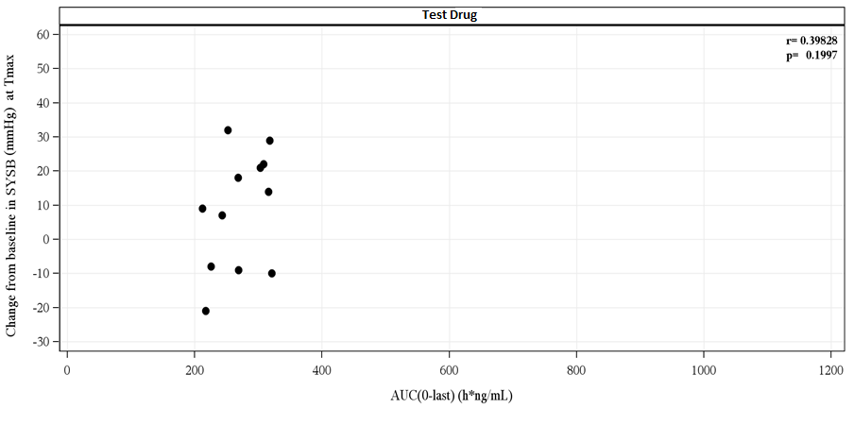
Plot of Change from Baseline in Systolic BP at T_{max} versus Test drug Exposure (AUC_{0-last}) (PD Population)
PK/ PD Analysis (Contd.)

Slide 25
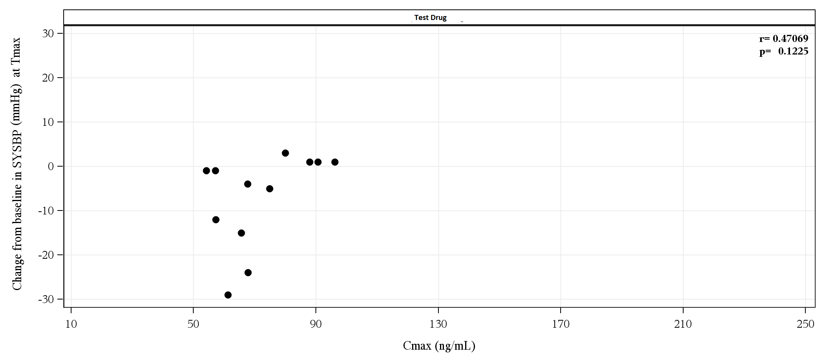
Plot of Change from Baseline in Systolic BP at T_{max} versus maximum concentration (C_{max}) of Test drug (PD Population)
PK/ PD Analysis (Contd.)

Slide 26
PK/ PD Analysis (Contd.)
Design: Single-center, double-blind, single ascending dose, inpatient study in healthy adult subjects with sequential administration of up to 6 Dose Levels
PK/PD Objective: To assess the pharmacodynamic (PD) effects of Test drug alone, and (as needed) CVC with RTV 100 mg, on electrocardiogram (ECG) parameters with a focus on cardiac repolarization, as determined by the QTcF interval compared to placebo
PK/PD variable: The relationship for all time points with matching concentration data for each subjects of:
The change from baseline of the QTcF interval adjusted for the change from baseline of the QTcF for placebo with the plasma concentration of Test drug ; including:
the estimated change from baseline of the QTcF interval adjusted for the change from baseline of the QTcF placebo at the population mean C_{max} for each dose of Test drug and 90% confidence interval bounds

Slide 27
Analysis Table
Protocol Number Page X of Y
Table 14.2.3.1.x Placebo-Corrected Change from Baseline Versus the Test drug Plasma Concentration Estimates from Linear Mixed Model, QTcF (msec) (PD ECG Population)
Test 75 mg (N=XX) |  | Test 150 mg (N=XX) |  | Test 450 mg (N=XX) |  |  | Test 900 mg (N=XX) |  | Test 300 mg + RTV 100 mg (N=XX) |  | Moxifloxacin 400 mg (N=XX)
Therapeutic Predicted ΔΔQTcF at Mean Cmax = xxx.x unit | 95% Confidence Bound of Predicted ΔΔQTcF* | Therapeutic Predicted ΔΔQTcF at Mean Cmax = xxx.x unit | 95% Confidence Bound of Predicted ΔΔQTcF* | Therapeutic Predicted ΔΔQTcF at Mean Cmax = xxx.x unit | 95% Confidence Bound of Predicted ΔΔQTcF* |  | Therapeutic Predicted ΔΔQTcF at Mean Cmax = xxx.x unit | 95% Confidence Bound of Predicted ΔΔQTcF* | Therapeutic Predicted ΔΔQTcF at Mean Cmax = xxx.x unit | 95% Confidence Bound of Predicted ΔΔQTcF* | Therapeutic Predicted ΔΔQTcF at Mean Cmax = xxx.x unit | 95% Confidence Bound of Predicted ΔΔQTcF*
x.xxxx | x.xxxx – x.xxxx | x.xxxx | x.xxxx – x.xxxx | x.xxxx |  | x.xxxx – x.xxxx | x.xxxx | x.xxxx – x.xxxx | x.xxxx | x.xxxx – x.xxxx | x.xxxx | x.xxxx – x.xxxx
x.xxxx | x.xxxx – x.xxxx | x.xxxx | x.xxxx – x.xxxx | x.xxxx |  | x.xxxx – x.xxxx | x.xxxx | x.xxxx – x.xxxx | x.xxxx | x.xxxx – x.xxxx | x.xxxx | x.xxxx – x.xxxx

Slide 28
Case Study: US based Healthcare Company
End to end CDM, Biostatistics, Statistical Programming and Medical Writing activities for Phase 1 studies
Partnered for the HL7 processing of the lab data.
CDM – 20 FTE, B&P – 15 FTE and MW – 3 FTE.
TCS platform and system for B&P activities
e-Submission ready package delivery
CDASH standards implemented for CRF build
SAS macros for standard outputs, derivations and back end edit checks
CDM – Study Build and query management
B&P - SDTM , ADaM and TLF
CDM – CRF development activities, Medical coding
B&P – SAP authoring. PK activities started
MW –CSR shell development
CDM – CDASH standards, Third party management
B&P –HL7 lab data. eSubmission readiness
MW – Complete CSR development
CDM – Global macros for back end checks
B&P – Template programs, global macros
MW – Standardized CSR contents
Q3 2013
Q1 2014
Social Media
Services
Q4 2014
Q2 2015
Analytics
CDM Scope:
CRF development – CDASH standards
Dataset set-up
Query Management
Third Party Data Management
SAE Reconciliation
Medical Coding
Database Related Activities
B&P Scope:
Randomization schedule generation
SAP and Mock shell tables
SDTM, ADaM and TLF
PK merge & PK analysis
Managing HL7 lab data
Inputs to CSR
e-Submission package generation
MW Scope:
CSR mock shell
Final CSR writing
28

Slide 29

Thank You

